Slide 1
What happens when you hit google.com
The journey of data through the internet
Notes:
What do you think this topic means? What are we going to talk about? Clue - The journey of data through the internet.

Slide 2
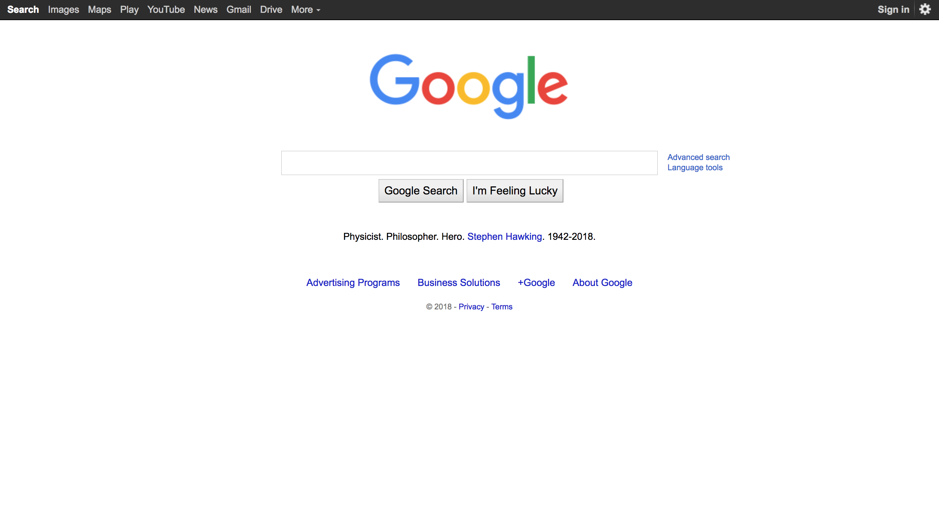
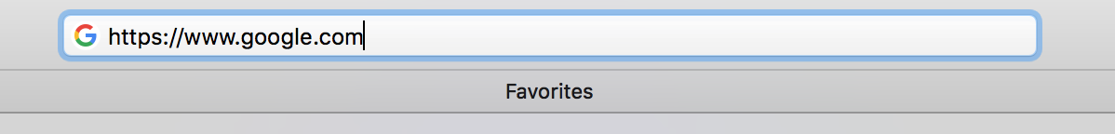
What we’re going to talk about
Press Enter

Slide 3
What happens when you hit google.com
Notes:
Keyword in the title? => Hit

Slide 4
What does hit mean?
Hit - To request an item from a Web Server
What’s the weather?
Question
Request
Answer
Response
Web Browser (or) Client
Curious guy
Friendly weatherman
Web Servers
Notes:
Before next slide : This is the most abstract understanding of what happens when you hit google.com. But lets dig a little deeper.

Slide 5
Let’s dig a little deeper
What does the request look like?
What does the response look like?
How does the request find the Web Server?
Notes:
Web Server example - Festember server in Singapore

Slide 6
Let’s dig a little deeper
Request
Response
Web Browsers
Web Servers
Notes:
This slide is here just to reiterate the 3 points on the previous slide. Use the drawer/pointer as you’re talking.

Slide 7
What does the request look like?
What’s the weather?
Request
: What’s the weather?
Curious guy
Friendly weatherman
It’s just an English Sentence

Slide 8
But what happens here?
What’s the weather?
They agreed on a set of rules
Request
Web Browsers
Web Servers
It’s just an English Sentence
Notes:
Request is definitely NOT an English sentence.
Intro to Protocols : The only reason this works is both agreed to speak in English. What if one speaks English and other speaks French (and Vice-Versa)

Slide 9
Protocols
A set of rules that both the client and server agree on
There are many protocols. The one that World Wide Web uses is called HTTP.
A request made using the HTTP is called a HTTP Request.

Slide 10
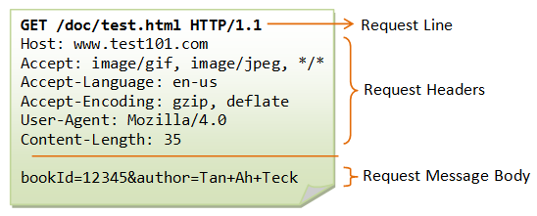

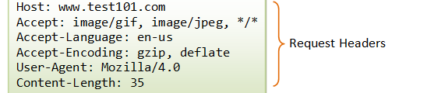
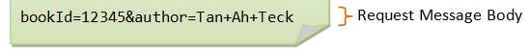
HTTP Request
A HTTP Request consists of 3 parts :-
Request Line
Request Headers
Request Message Body
3. Request Message Body
2. Request Headers
1. Request Line
Notes:
Circle each part of the Request Line while talking about it.
Key-Value Pairs : Student-name, Student ID example
Request Message Body (example for parameters) : Festember log in.
Mention that gzip and deflate are used for compression.
Mention that this HTTP Request becomes 1s and 0s before being sent.

Slide 11
Let’s dig a little deeper
What does the request look like?
2. What does the response look like?
3. How does the request find the Web Server?

Slide 12
What does the response look like?
What’s the weather?
Response
: It’s 32 degrees outside.
It’s just an English Sentence

Slide 13

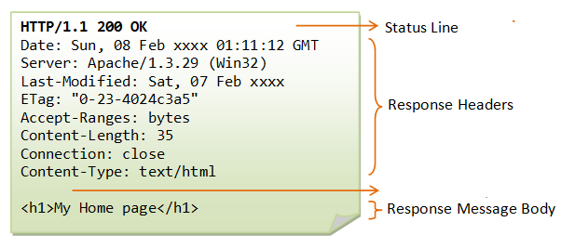
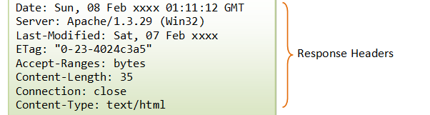

HTTP Response
A HTTP Response consists of 3 parts :-
Status Line
Response Headers
Response Message Body
3. Response Message Body
2. Response Headers
1. Status Line
Notes:
Circle each part of the Status Line while talking about it.

Slide 14
Quick Summary
HTTP Request
HTTP Response
Web Browsers (or) Clients
Web Servers
Notes:
Hit enter on Web Browser.
Both client and servers agree on a set of rules - Protocol - HTTP
Browser sends a HTTP Request
Web Server parses/decodes that HTTP Request.
Web Server sends back a HTTP Response.
Browser parses/decodes that Response and displays the HTML.

Slide 15
Let’s dig a little deeper
What does the request look like?
2. What does the response look like?
3. How does the request find the Web Server?

Slide 16
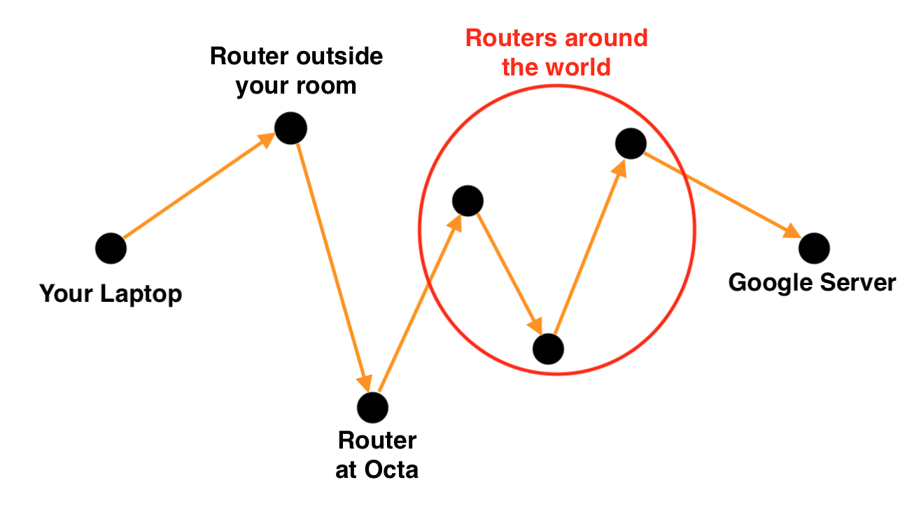
How does the request find the Web Server?

Slide 17
IP Address
An IP Address is a 32 bit number that uniquely identifies each and every device on the internet.
The Web Server that hosts google.com also has a unique IP Address.
10101100110110010001111101101110
172.217.31.110

Slide 18

How does the request find the Web Server?
https://www.google.com = 172.217.31.110
HOW?
Notes:
Green circle the IP Address. => This is what the destination of the request actually is.

Slide 19
DNS Servers
DNS Servers map a domain name (google.com) to an IP Address (172.217.31.110)
google.com
172.217.31.110
Web Browsers
DNS Servers

Slide 20
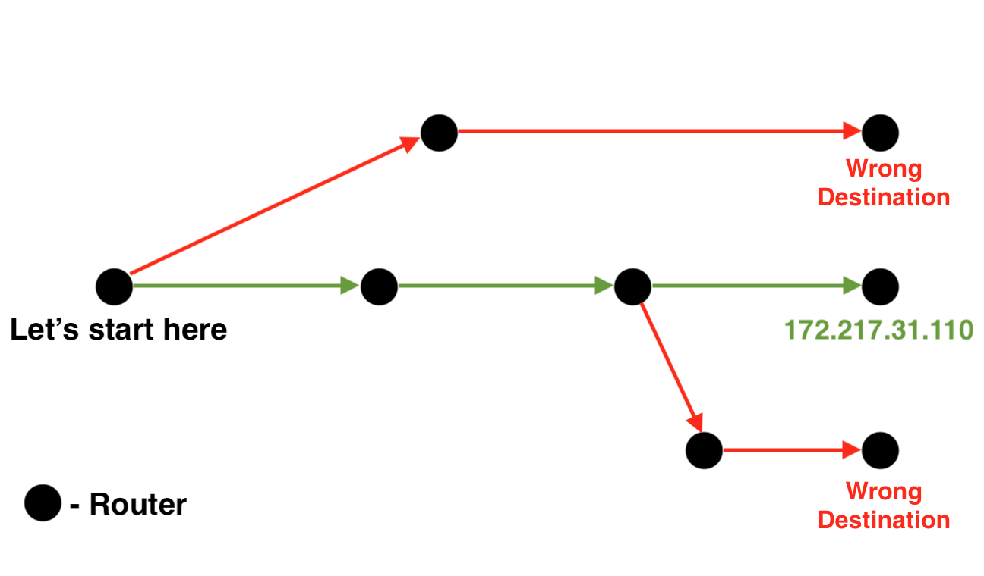
How does the request find the Web Server?
A More Accurate Representation

Slide 21
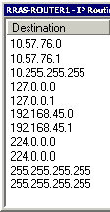
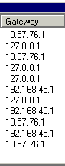
Routing Tables

Slide 22
Now let’s put it all together (finally)

Slide 23
google.com
DNS Servers
172.217.31.110
HTTP Request
HTTP Response
Web Browser
Web Servers

Slide 24
Peace

